Slide 1


Slide 2

A Short History of Git
The Linux kernel. Open Source. Farily large scale.
As of 2017 (on GitHub):
707,346 commits
529 releases
In September, 461 authors have pushed 1,127 commits to master

Slide 3
A Short History of Git
For most of the lifetime of the Linux kernel maintenance (1991–2002), changes to the software were passed around as patches and archived files.
In 2002, the Linux kernel project began using a proprietary DVCS called BitKeeper.
In 2005 the tool’s free-of-charge status was revoked.
So Linus Torvalds wrote Git.

Slide 4
Git’s major features
- Designed from the ground as a DVCS.
- Being distributed version control system means that multiple redundant repositories and branching are first class concepts of the tool

Slide 5
Git’s major features
- Every user has a backup
- In a distributed VCS like git every user has a complete copy of the repository data stored locally, thereby making access to file history extremely fast, as well as allowing full functionality when disconnected from the network.

Slide 6
Git’s major features
- Have 20 users?
- You probably have more than 20 complete backups of the repository as some users tend to keep more than one repository for the same project.

Slide 7
Git’s major features
- You, as any other user, have full control over local working copy of a repository
- No one can say:
“You are too stupid to do your work as you want to, we have to enforce you to… <put here 1 of 82 Odyssey pre-commit hooks>”

Slide 8
Performance
- Git is extremely fast (unless you are in CS). Since all operations (except for push and fetch) are local there is no network latency involved to:
- Perform a diff
- View file history
- Commit changes
- Merge branches
- Obtain any other revision of a file
- Switch branches

Slide 9
Performance
- Git’s repositories are extremely small when compared to other systems, like SVN.
- For example Mozilla repository is reported to be almost 12 GB when stored in SVN using the fsfs backend. Previously the fsfs backend also required over 240k files in one directory to record all 240k commits made over the 10 year project history. This was fixed in SVN 1.5 where every 1k revisions are placed in a separate directory. The same history is stored in Git by only two files totaling just over 420 MB. This means that SVN requires 30x the disk space to store the same history.

Slide 10
Git Has Integrity
- Everything in Git is check-summed before it is stored and is then referred to by that checksum. This means it’s impossible to change the contents of any file or directory without Git knowing about it. This functionality is built into Git at the lowest levels and is integral to its philosophy. You can’t lose information in transit or get file corruption without Git being able to detect it.
- The mechanism that Git uses for this checksumming is called a SHA-1 hash. In fact, Git stores everything in its database not by file name but by the hash value of its contents.
Notes:
SHA-1 no other input data should ever produce the same hash. The same input data however should always produce exactly the same hash.
The parent commit hash is also part of the commit hash. That's why you cannot just change one commit in the middle of a commit tree without changing the whole history coming after the changed commit. (Blockchain?)

Slide 11
It is really hard to screw up your data
- When you do actions in Git, nearly all of them only add data to the Git database. It is hard to get the system to do anything that is not undoable or to make it erase data in any way. As in any VCS, you can lose or mess up changes you haven’t committed yet; but after you commit a snapshot into Git, it is very difficult to lose, especially if you regularly push your database to another repository.

Slide 12
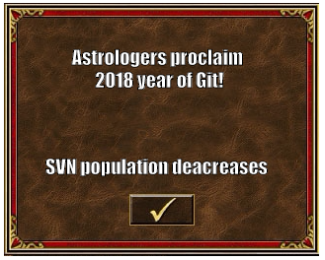
- OK let’s kick it off man

Slide 13
Which Git tool is the best one and why is it Git Bash / Console

Slide 14
Snapshots, Not Differences

Slide 15
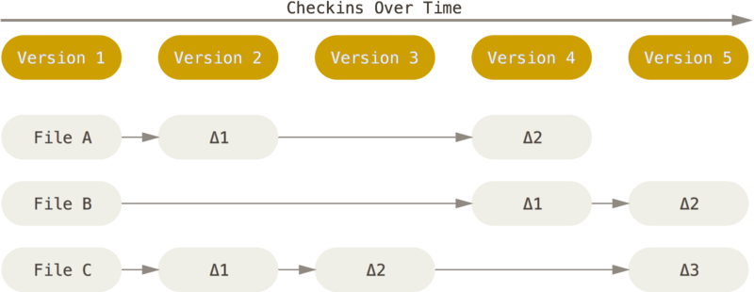
Conceptually, most other systems store information as a list of file-based changes. These systems (CVS, Subversion, Perforce, Bazaar, and so on) think of the information they keep as a set of files and the changes made to each file over time.

Slide 16
Git is a miniature file system
Every time you commit, or save the state of your project in Git, it basically takes a picture of what all your files look like at that moment and stores a reference to that snapshot. To be efficient, if files have not changed, Git doesn’t store the file again, just a link to the previous identical file it has already stored. Git thinks about its data more like a stream of snapshots.

Slide 17

The Three (main) States
Committed means that the data is safely stored in your local database.
Modified means that you have changed the file but have not committed it to your database yet.
Staged means that you have marked a modified file in its current version to go into your next commit snapshot.

Slide 18
New repo
Notes:
Init
Clone (default and custom directory name)
Fork

Slide 19
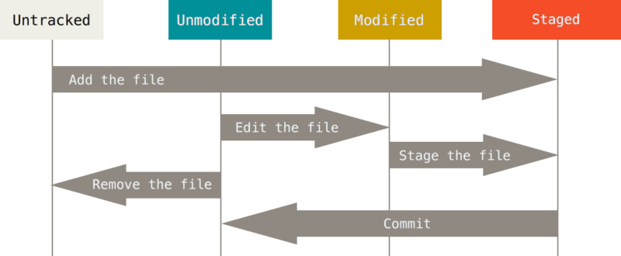
Recording changes to the repo
++ gitignore
Notes:
Git stages a file exactly as it is when you run the git add command.

Slide 20
Commit
Notes:
If you want to skip the staging area, Git provides a simple shortcut. Adding the -a option to the git commit command makes Git automatically stage every file that is already tracked before doing the commit, letting you skip the git add part: git commit -a -m 'added new benchmarks’
Amend

Slide 21
Push
Notes:
Git blame –show-line-number

Slide 22

Blame
„He who lives by the sword shall die by the sword”
Notes:
Git blame –show-line-number

Slide 23
Branch
Git doesn’t store data as a series of changesets or differences, but instead as a series of snapshots.
Notes:
Git blame –show-line-number

Slide 24
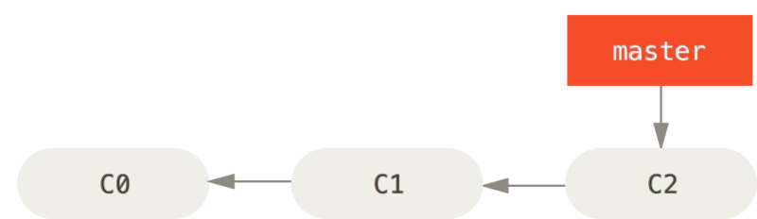
Merge
Fast forward merge
Three way merge
Resolving merge conflicts
Notes:
You’ll notice the phrase “fast-forward” in that merge. Because the commit C4 pointed to by the branch hotfix you merged in was directly ahead of the commit C2 you’re on, Git simply moves the pointer forward. To phrase that another way, when you try to merge one commit with a commit that can be reached by following the first commit’s history, Git simplifies things by moving the pointer forward because there is no divergent work to merge together – this is called a “fast-forward.”

Slide 25
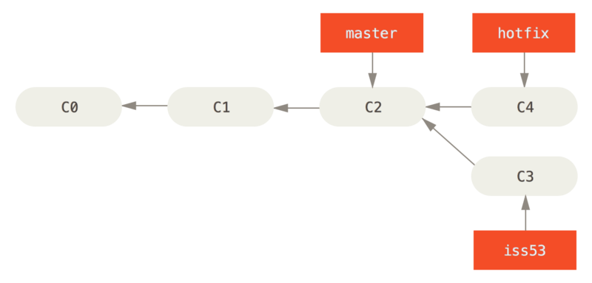
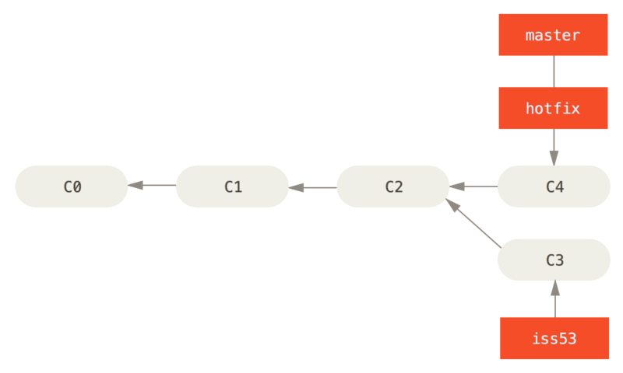
Fast-forward merge
Notes:
You’ll notice the phrase “fast-forward” in that merge. Because the commit C4 pointed to by the branch hotfix you merged in was directly ahead of the commit C2 you’re on, Git simply moves the pointer forward. To phrase that another way, when you try to merge one commit with a commit that can be reached by following the first commit’s history, Git simplifies things by moving the pointer forward because there is no divergent work to merge together – this is called a “fast-forward.”

Slide 26
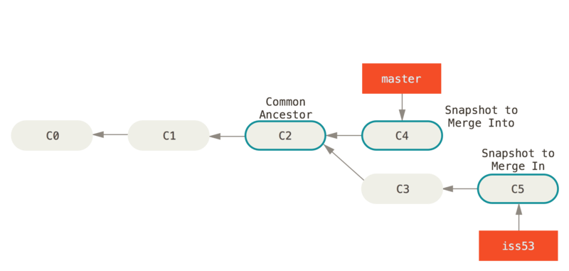
Three-way merge
Notes:
You’ll notice the phrase “fast-forward” in that merge. Because the commit C4 pointed to by the branch hotfix you merged in was directly ahead of the commit C2 you’re on, Git simply moves the pointer forward. To phrase that another way, when you try to merge one commit with a commit that can be reached by following the first commit’s history, Git simplifies things by moving the pointer forward because there is no divergent work to merge together – this is called a “fast-forward.”

Slide 27
Rebase
Notes:
Git blame –show-line-number

Slide 28
Rebase
Do not rebase commits that exist outside your repository.
If you follow that guideline, you’ll be fine. If you don’t, people will hate you, and you’ll be scorned by friends and family.
Notes:
Git blame –show-line-number

Slide 29
Undoing things
Notes:
Git blame –show-line-number

Slide 30
Reset
Notes:
Git reset to unstage
Git reset –hard
Git reset –hard origin/master

Slide 31
Amend

Slide 32
Revert

Slide 33
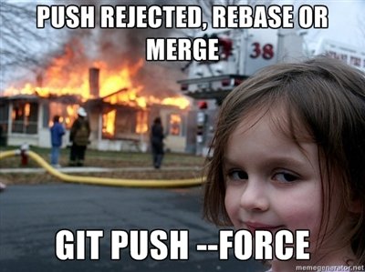
Force Push
Notes:
Git blame –show-line-number

